Slide 1





QR Decomposition for PCA on Digits Dataset
Presented By:
Md. Mehedi Hasan
Abdullah
2102016
2102074
10143
10201

Slide 2

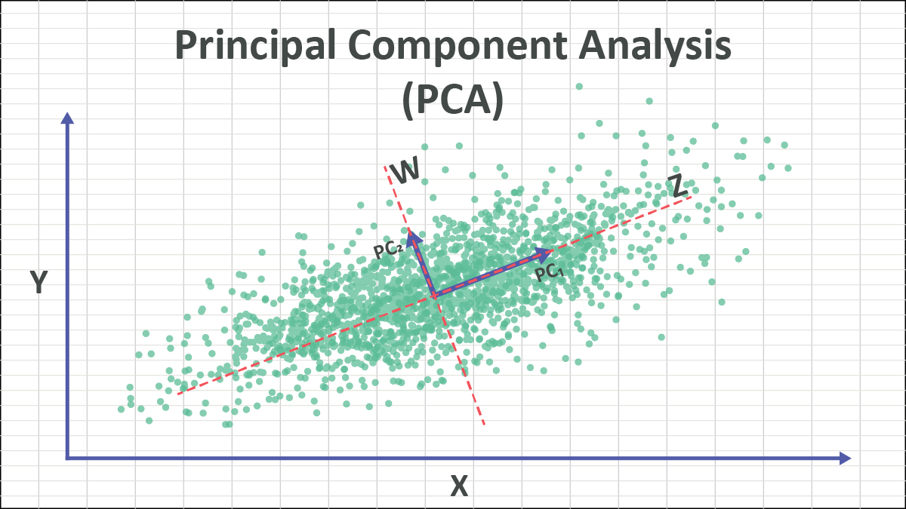
Introduction
What is it?
01
Principal Component Analysis (PCA) is a technique that reduces the number of features in data by keeping the most important information and simplifying the dataset.
PCA typically reduces data with 64 or more features down to only 2 to 3 principal components.
QR Decomposition is a mathematical method that breaks data into two parts —
an orthogonal matrix Q and
an upper triangular matrix R
to make calculations easier and faster.
02

Slide 3
Comparative Analysis
Traditional PCA
Step 1: Mean centering
Step 2: Covariance matrix
Step 3: Eigen-decomposition
Step 4: Principal components
QR-based PCA
Step 1: Mean centering
Step 2: Transpose -> QR decomposition
Step 3: SVD on R.T
Step 4: Eigenvectors = Q × V
Computational Cost : O(d3)O(d^3) for eigen
QR: O(nd2)O(nd^2), SVD: O(d3)O(d^3) but on smaller matrix

Slide 4

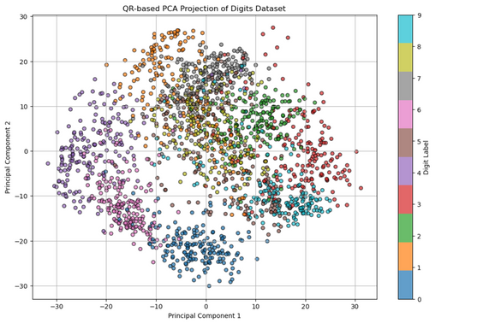
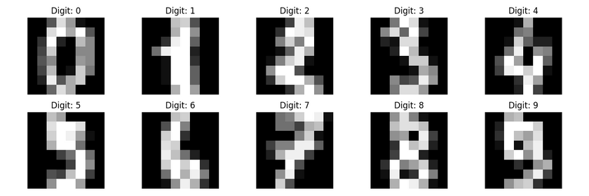
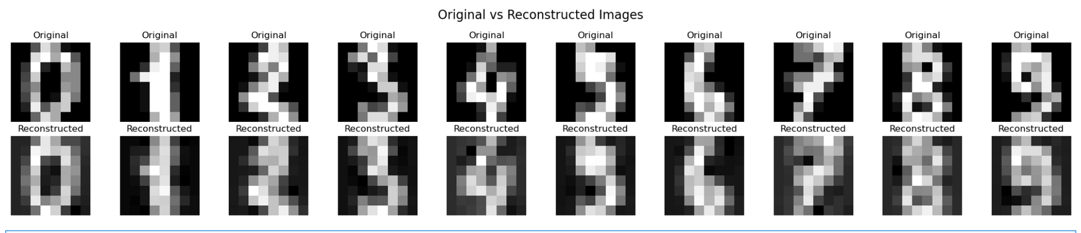
Overview
Principal Component Analysis
2D space
Digit Dataset
Reconstraction
QR Decomposition

Slide 5


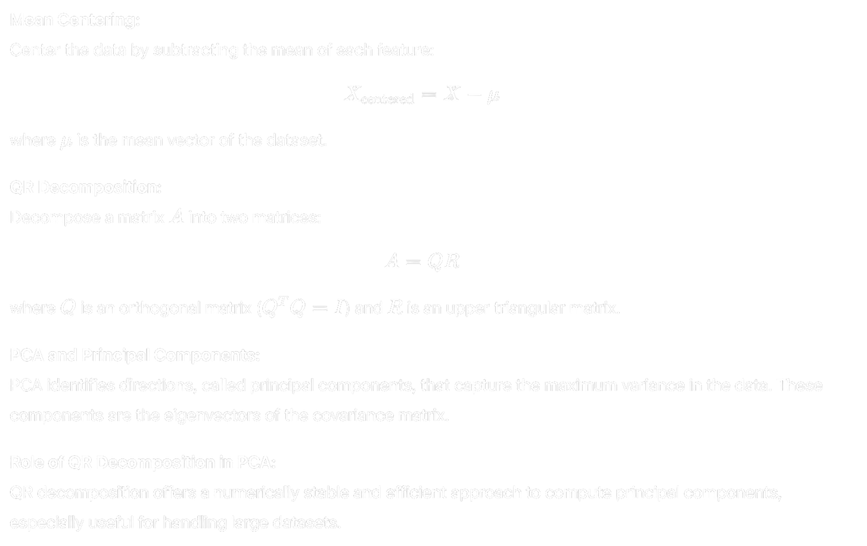
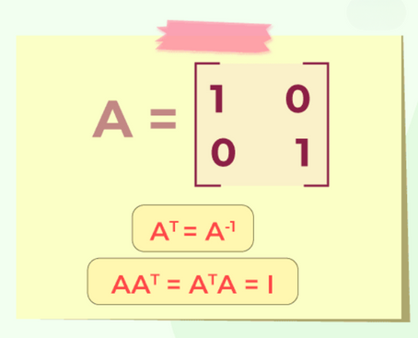
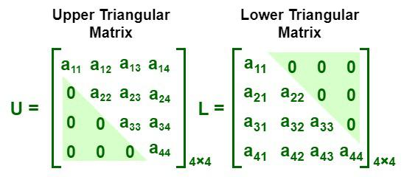
Mathematical Background
Fig: Orthogonal Matrix
Fig: upper triangular matrix

Slide 6


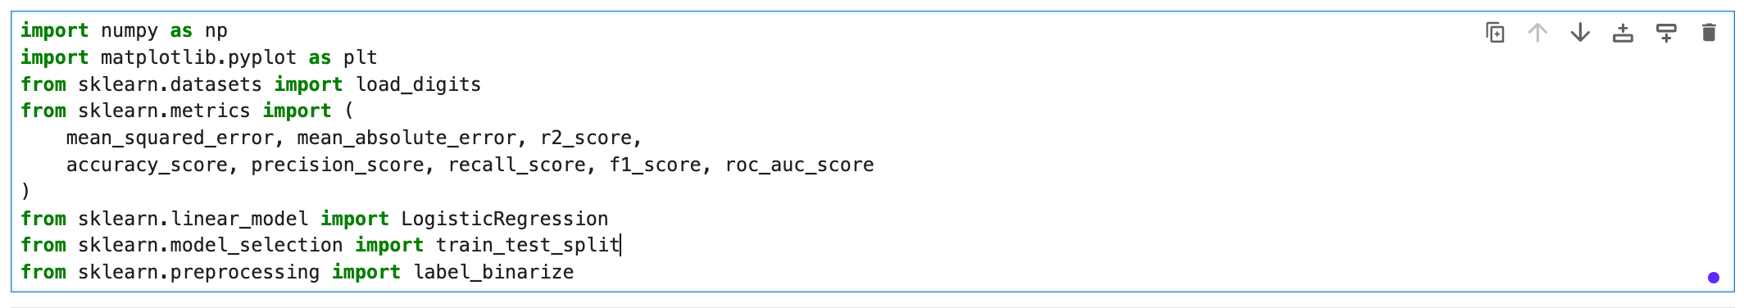
Selecting libraries:
numpy: Numerical operations and array handling
matplotlib.pyplot: Visualization of results
sklearn.datasets: Load the built-in digits dataset
sklearn.metrics: Evaluate model performance using various metrics
sklearn.linear_model: Use Logistic Regression classifier
sklearn.model_selection: Split data into training and testing sets
sklearn.preprocessing: Convert labels to binary format for ROC AUC

Slide 7
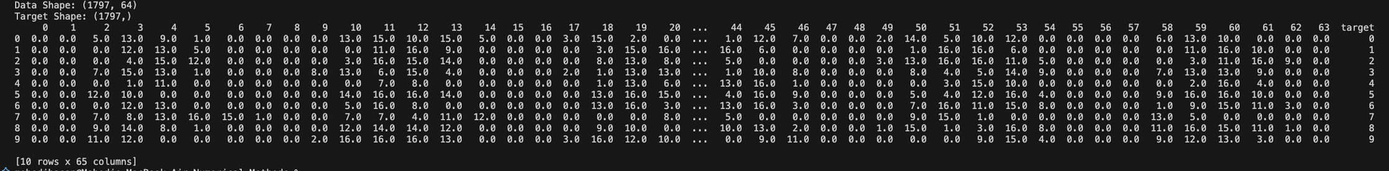
Digits Dataset:
Dataset Overview
Source: sklearn.datasets.load_digits()
Samples: 1,797 handwritten digit images
Features: Each image is 8×8 pixels → flattened into 64 features
Row: 10 (0-9)
Column: 64(0-63)

Slide 8

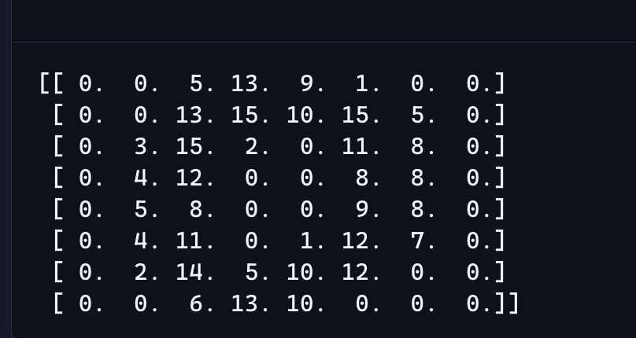
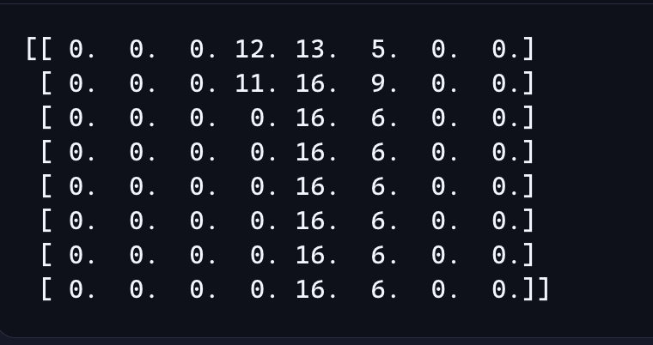
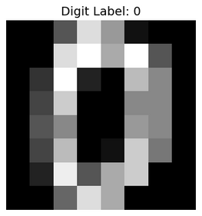
Digit Breakdown
Digit: 0
Digit: 1
This matrix is a grayscale image of a digit.
Each number in the matrix represents the brightness of a pixel.
The entire matrix contains 64 pixels, arranged as an 8×8 image.
Pixel value 0 → black
Pixel value 8 → medium gray
Pixel value 16 → white

Slide 9


Mean Centering:
What happens when you do Mean Centering?
The mean of each feature is 0
The data is balanced around the origin
PCA can then accurately capture variation
What happens if you don't do Mean Centering?
If the data is not centered (mean = 0), then PCA can show the wrong direction.
PCA then does not calculate from the origin (0,0), but becomes biased.

Slide 10
QR Decomposition: (H=QR)
What is QR Decomposition?
QR decomposition splits a matrix into:
Q: an orthonormal matrix
R: an upper triangular matrix
Why Use QR in PCA?
Faster and more stable than eigen-decomposition
Helps extract principal directions efficiently
Ideal for high-dimensional data
Fig: Orthogonal Matrix
Fig: upper triangular matrix

Slide 11
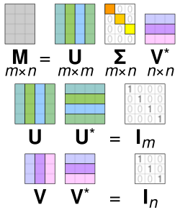
SVD on R1TR1T
What is SVD?
Singular Value Decomposition (SVD) breaks a matrix into:
U: left singular vectors
D: singular values (--> eigenvalues) (variance)
Vᵗ: right singular vectors (Eigenvectors (PCA basis))
Eigenvectors
Why SVD on R1TR_1^T?
R1TR_1^T is compact decomposition and well-conditioned
SVD helps extract principal components directly
Avoids computing large covariance matrices
eigenvalues

Slide 12



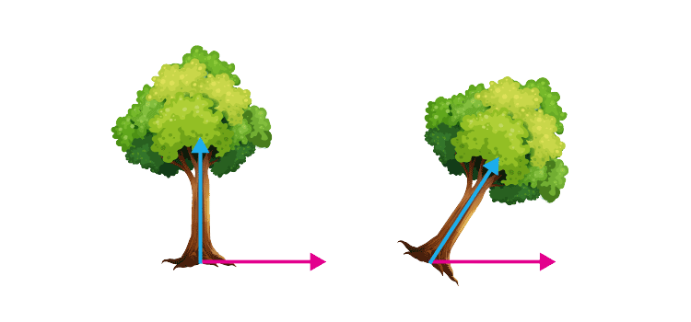
Eigenvalues & Eigenvectors:
What do eigenvalues mean?
They indicate how much variation each principal component captures in the data.
A larger eigenvalue means the component is more important.
What do eigenvectors mean?
The directions in which the data is spread are called eigenvectors.
PCA projects the data in these directions.
Why Compute Them in PCA?
They define the new feature space
Help rank components by importance
Used to project data into lower dimensions
eigenvectors
eigenvectors

Slide 13

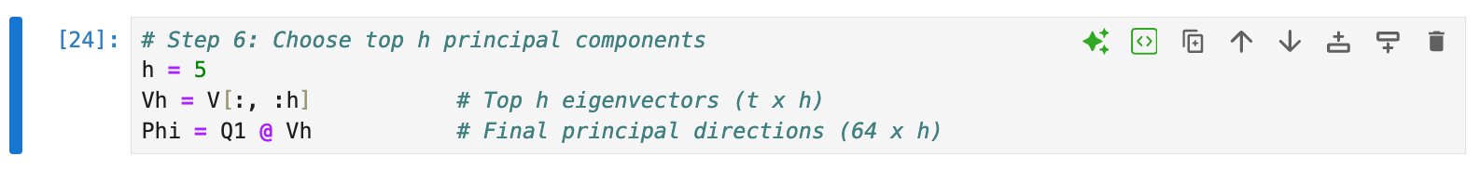
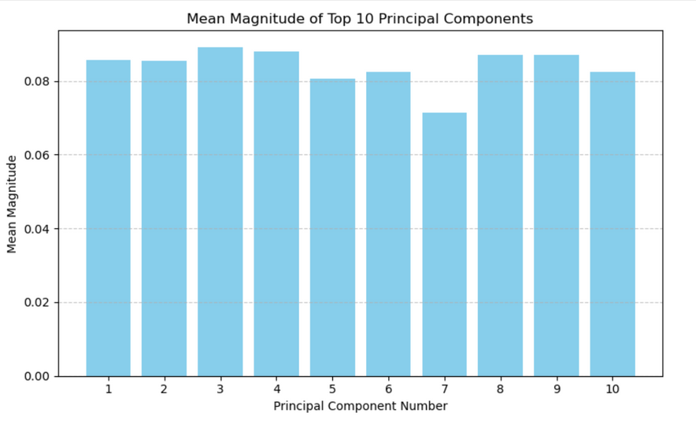

Principal Components:
What Is This Step?
In PCA, we get all the principal components, but we don't need all of them.
We keep only the top h components — the ones that capture the most variance.
This reduces dimensionality, simplifies computation, and reduces noise.

Slide 14
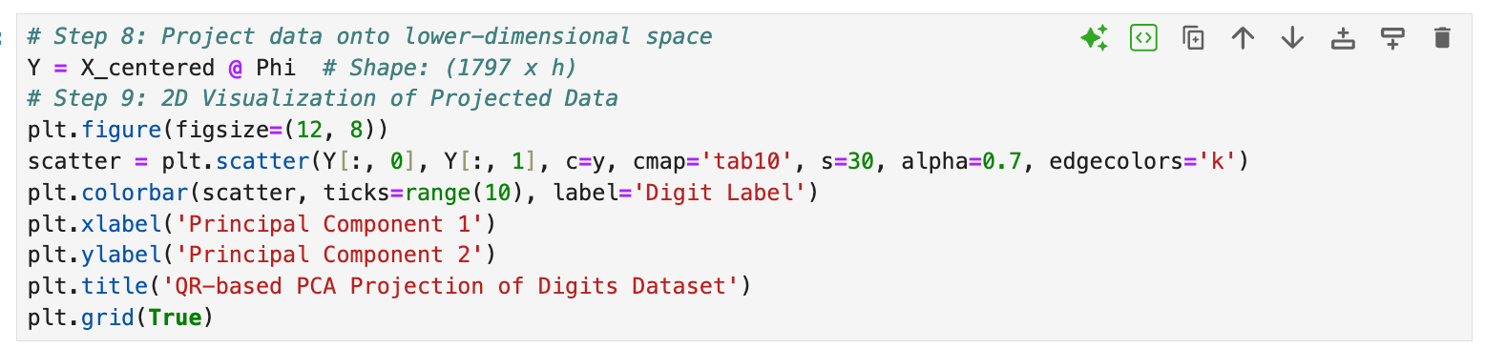
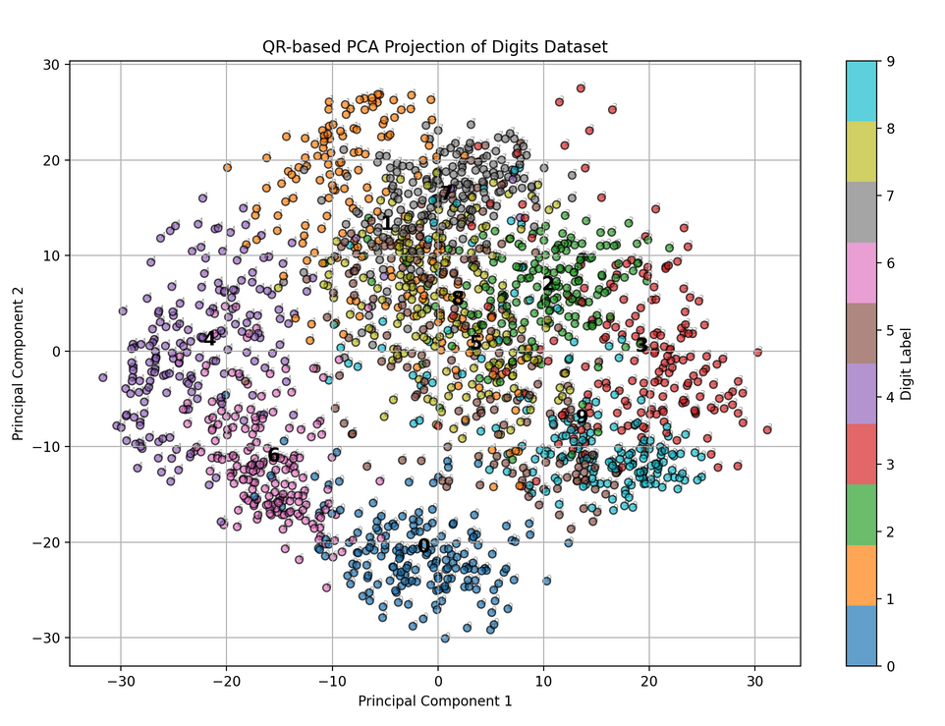
QR-based PCA Projection
What This Shows
Each point = one digit image (0–9)
Total points = 1797 digit samples
Position = PCA-projected coordinates (shows shape similarity)
Color = digit label (0–9), used to distinguish classes visually

Slide 15
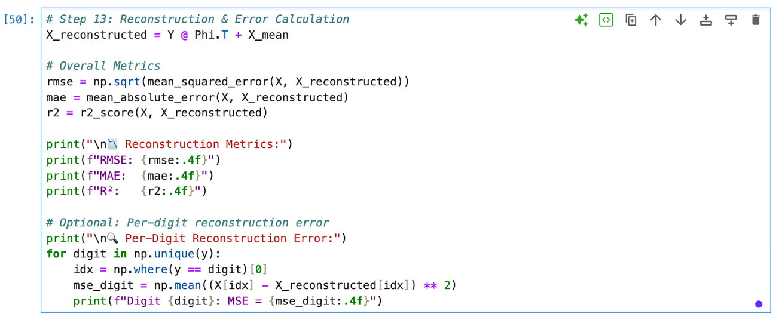
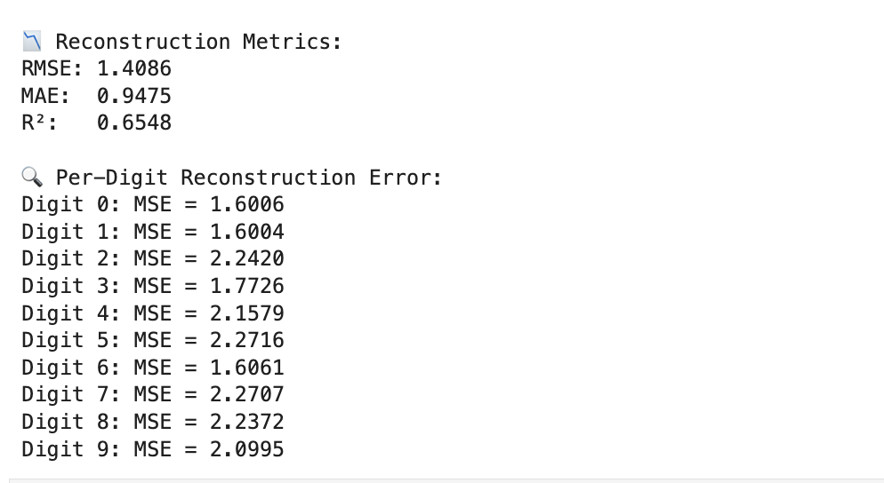
Reconstruction & Error Calculation
Overall Metrics:
RMSE: Reconstruction error
MAE: Average deviation
R² Score: Variance retention quality

Slide 16
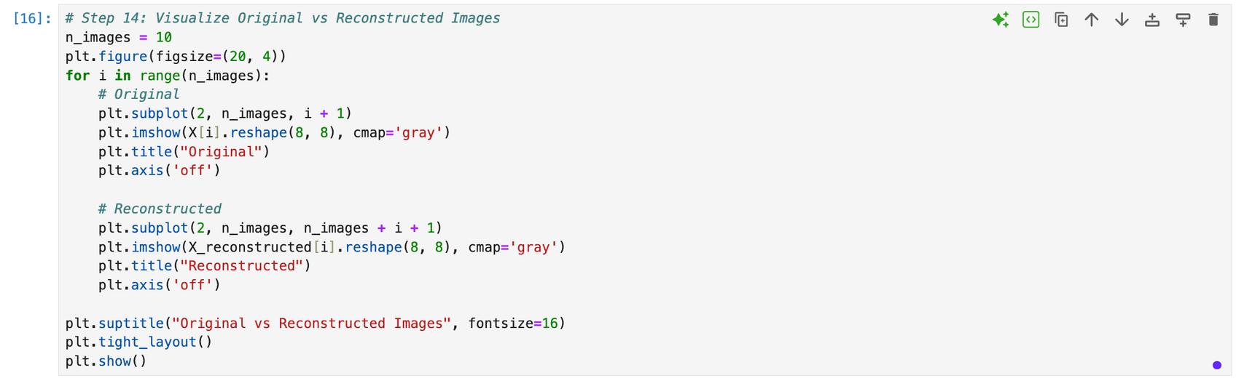
Visualize Original vs Reconstructed Images

Slide 17
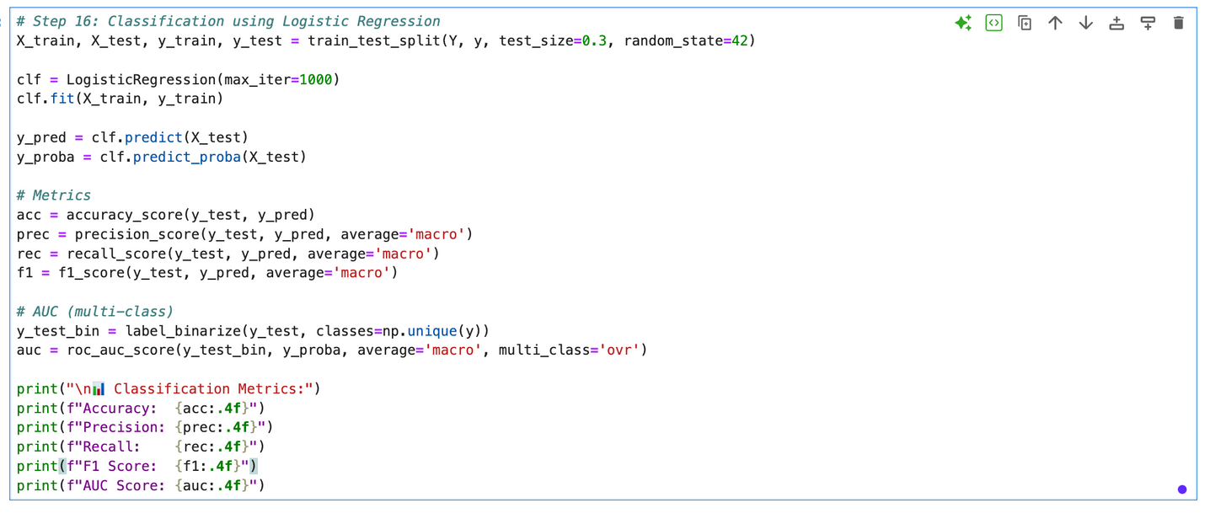
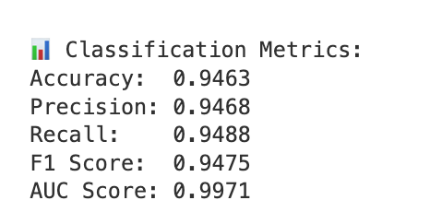
Classification using Logistic Regression

Slide 18
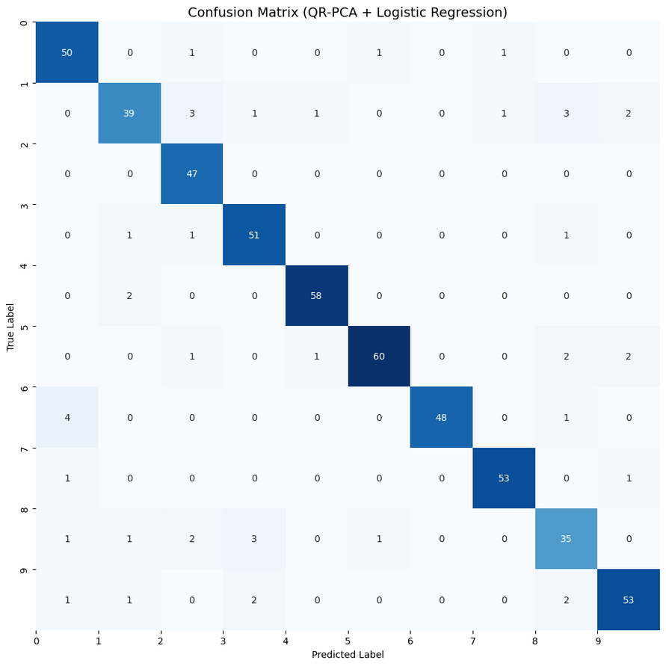
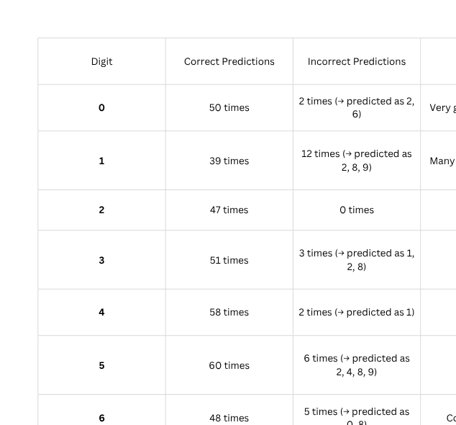
Confusion Matrix

Slide 19


